Slide 1
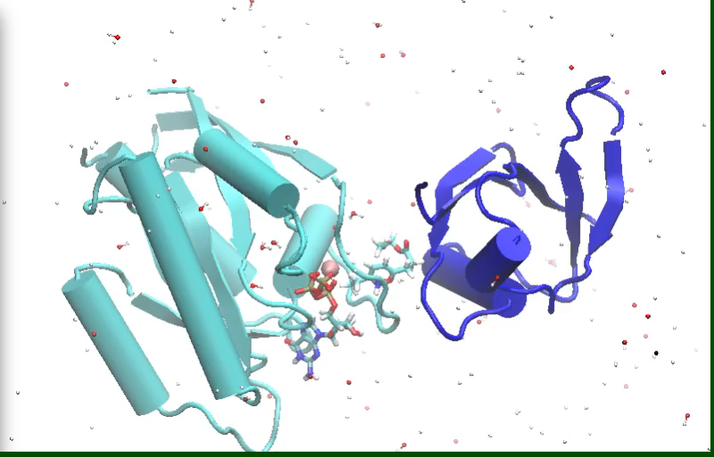
Molecular Dynamics Simulations
Erandi Madawalagama
18/08/2021,25/08/2021

Slide 2
What is covered in this workshop
Introduction
Terms
Steps
Programs
Example

Slide 3
What is Molecular Dynamics Simulation and Why we need it?
MD is a process to study the dynamic nature of a system using a computer simulation.
Some applications
Structure, interactions & thermodynamics of biological molecules & complexes.
Time dependent behavior of a molecular system.
Fluctuations and conformational changes of proteins & nucleic acids etc
Develop more realistic models.

Slide 4
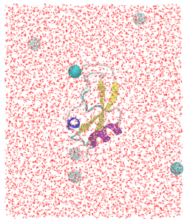
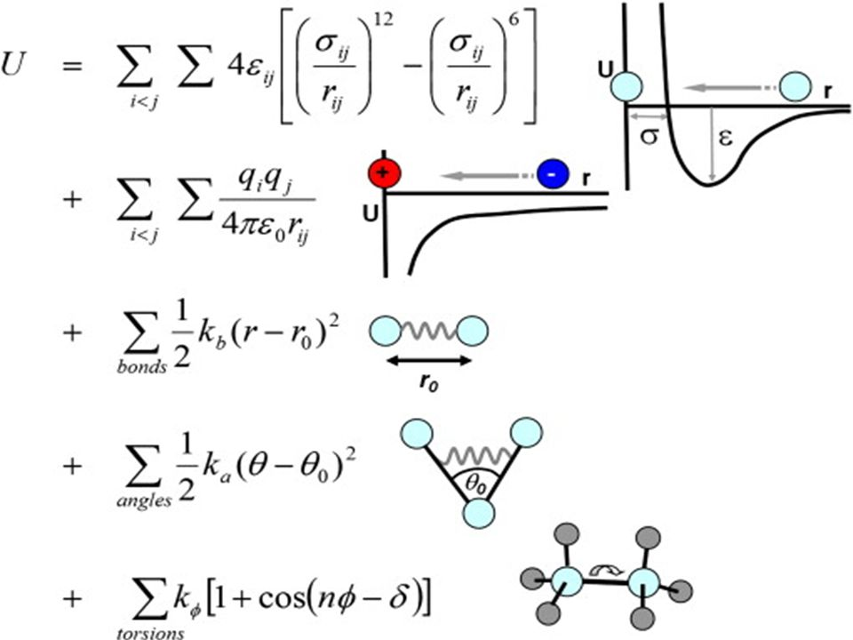


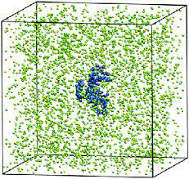
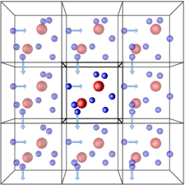

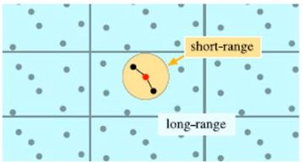
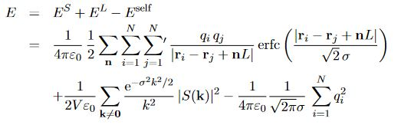
Mathematics behind Molecular Dynamics Simulations.
Forcefield- Amber, Gromos, Charmm etc
F_{i}(t)=ma_{i}(t)
Numerical integration-Verlet, Leapfrog etc
Non bonded energy, non bonded lists & Cutoffs
Periodic boundary conditions
Ewald method
-Particle mesh Ewald

Slide 5
Steps of a Molecular Dynamics Simulation.
Build a realistic atomistic model of the system.
Simulate the behavior of system over time using specific conditions (T, P, V etc).NVE, NVT, NPT, µVE
Analyze the results obtained from MD & relate to macroscopic level properties. RMSD, Rg etc

Slide 6
Programs
Avogadro, Maestro
VMD, Chimera, Discovery Studio
Gromacs, CHARMM, NAMD, OPENMM etc
CgenFF server, Swissparam server, Propka etc

Slide 7
GROMACS
Open source
Constant development
Well documented
Fast
User friendly
Support many forcefields

Slide 8
CHARMM
Installation
./configure cd build/cmake make make install
./configure --help

Slide 9
Steps of a Molecular Dynamics Simulation.(Contd.)
Setting up the system. pdb-> .crd , .psf
Solvation
Neutralization
Energy Minimization
Equilibration
Molecular dynamics

Slide 10
Steps of a Molecular Dynamics Simulation.(Contd.)
Setting up the system. pdb-> .gro , .top
Solvation
Neutralization
Energy Minimization
Equilibration-NPT,NVT
Molecular dynamics

